Slide 1
The Primary Keys
COS 221 Practical Assignment 5

Slide 2
Members
Conner Bell
Dewald Colesky
Adriano Jorge
Zoë Joubert
Inge Keyser
Megan Lai
Johan Nel

Slide 3
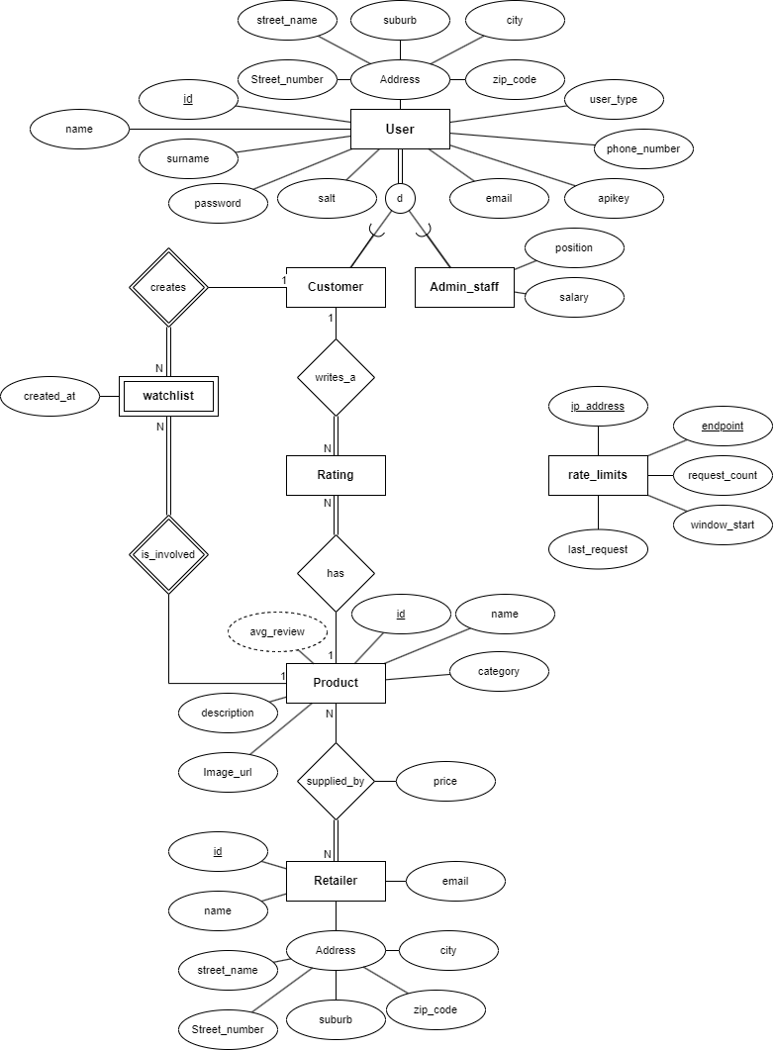

Slide 4
(E)ER Diagram
User is a strong entity with a disjoint specialization based on user_type. User has total participation. Every User must be either a Customer or Admin_staff.
Customer and Admin_staff is disjointed. A person in our system must have a role.
A Customer can add products to watchlist and can write reviews on products.

Slide 5
(E)ER Diagram
avg_review is a derived attribute of Product. It is calculated from Rating entries (score) that are associated with this product.
Watchlist is a weak entity: It cannot exist without both a Customer and a Product. It has no unique attribute to identify it alone. It is identified by a composite key (customer_id and product_id).
Rating is a strong entity: It has its own primary key (id), and while it references both Customer and Product, it can exist independently.

Slide 6
(E)ER Diagram
The rate_limits entity is a standalone system-level control table used to enforce rate-limiting mechanisms on the API. It is not part of the business (e.g., users, products, orders), but is essential to prevent API abuse.
endpoint and ip_address form a composite primary key, uniquely identifying each tracked client-endpoint pair. This entity has no relationships to any other entities - its role is entirely operational/systemic.

Slide 7
Relationships
Customer creates Watchlist
Called independent or something
total participation?
Product is_involved Watchlist
Customer writes_a Rating
Product has Rating
Product supplied_by Retailer

Slide 8
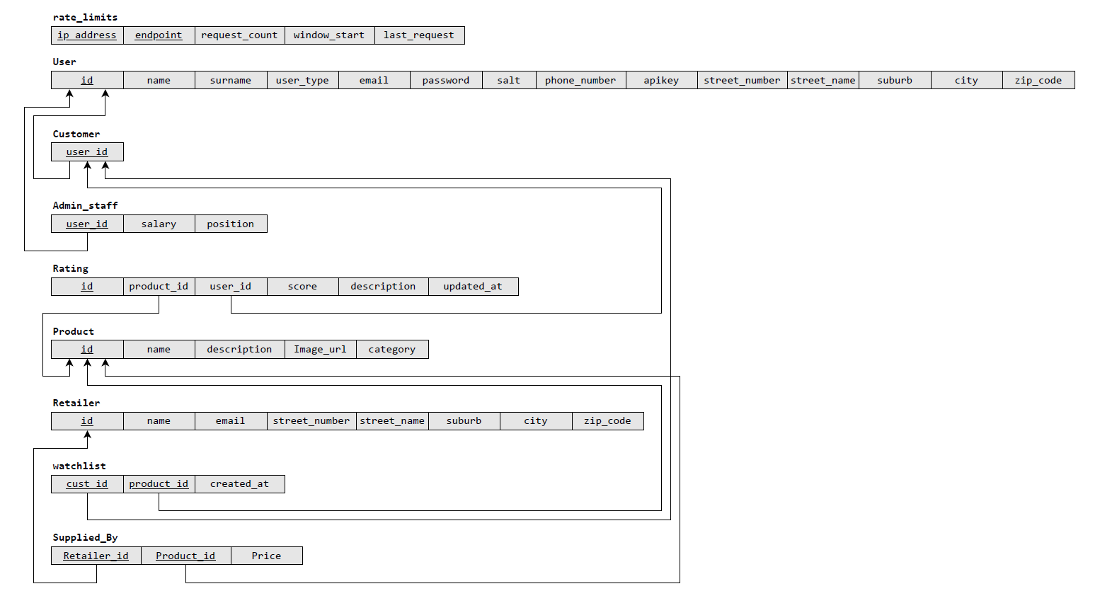

Slide 9
Functionality
Login and manage users
• Make changes to products and categories
• Manage stockists
• Sort and filter products
• Make changes to the database
• View a products
• Allow users to rate and/or review products
• View top-rated and reviews of products
• SQL injection prevention

Slide 10
Security
All API endpoints are protected against SQL injection attacks.
The API uses:
prepared statements,
parameter binding,
and input validation
to ensure that user input cannot manipulate SQL queries to perform unauthorized actions on the database.
Also hashing, Johan will give tomorrow

Slide 11
Population of the Database
• Ask Dewald for sites or generational software he used

